Slide 1
Process Improvement Opportunity:
CREATE APP & USE AI TO AUTOMATE
Target Stakeholder Group:
Internal Teams(downstream)

Slide 2
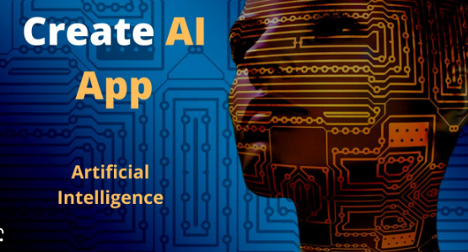
Need to create an Application
Use the AI intelligently

Slide 3
Key point, observation or data here…
First we need to create an application for the users and stake holders
Users can use this app for uploading documents, applying for loan and track the application status
Simultaneously we need to develop the same app which can be used for all stake holders(Appraisal/Title/Insurance company)
Use AI to validate the applicant details and pre qualification criteria
Use AI to validate the documents and automate this process so that it will automatically initiate notice to required stake holders

Slide 4
Key point, observation or data here…
Then application approval/ rejection notification will be sent via app so that users can re upload the documents if required
We can use AI intelligently to validating the process and can be Hussle free for the all stake holders

Slide 5
Summary
Create an app for loan application process
Users can upload their documents using app
Then use AI to validate the documents and using Automation can reject/approve the pre-qualification
Borrowers can track their application state in the Application

